Slide 1
ChatGPT
and Teaching Accounting:
Threats and Opportunities
James D. Stice
Earl K. Stice
Professors of Accounting Emeriti
Brigham Young University

Slide 2
ChatGPT: Key Points
Background
What is ChatGPT?
From where did it come? Who owns ChatGPT?
What are people saying about ChapGPT? How will it “change the world”?
Samples of ChatGPT Responses
What are the key points of the U.S. Constitution?
Is 17077 a prime number?
What is the journal entry to record the purchase of $4,000 of inventory for cash?
Systematic Research with ChatGPT and Accounting Homework, Quiz, and Exam Questions
David Wood
Jim Stice

Slide 3
ChatGPT: Key Points
What Should We Do? – Careful Questions
Dates, calculations, image files
What Should We Do? – Assigning Grades
Relative weights of homework, class participation, projects, and exams
What Should We Do? – ChatGPT as a Tutor?
Example: Give a problem and solution. Ask students to submit question to ChatGPT. Analyze the answer and explanation returned by ChatGPT. Is the answer correct? If not, describe EXACTLY where ChatGPT went wrong.
What Should We Do? – Enrich the Classroom
Benefits of well-designed, in-class, small-group activities
What Should We Do? – Enrich the Assignments!
Benefits of well-designed, out-of-class, PROJECTS

Slide 4
What is ChatGPT? Let’s Ask ChatGPT!!
ChatGPT is a large language model developed by OpenAI. It is based on the GPT-3.5 architecture, which stands for "Generative Pre-trained Transformer 3.5.” GPT-3.5 [has] been trained on vast amounts of text data to learn the structure and semantics of human language.
A large language model is a type of artificial intelligence model designed to process and generate human language. It is called "large" because it has an extensive number of parameters or trainable weights, which allow it to capture complex patterns and relationships in language data.

Slide 5
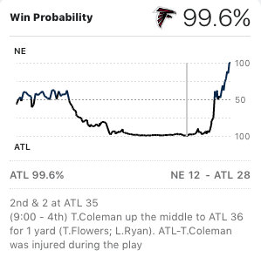
Sports In-Game Win Probabilities
Super Bowl 51
From where does this
percentage come?
Vast database of details of
games played
How can these data be used
to help a coach improve the
team’s odds of winning?
Use database to analyze the
change in win probability for
various play calls.

Slide 6
What is ChatGPT? Let’s Ask ChatGPT!!
GPT-3.5 has 175 billion parameters, which makes it one of the largest language models developed to date (as of my knowledge cutoff in September 2021).
Yes, creating and using these programs requires a HUGE among of computing power.
Note: GPT-4 is said to have between 1 trillion and 100 trillion parameters
======================================
GPT-3.5 is the underlying program.
ChatGPT is the conversational interface, a “chatbot” to engage in a conversation with a human user.

Slide 7
What are People Saying about ChatGPT?
MIT Technology Review, “ChatGPT is about to revolutionize the economy. We need to decide what that looks like.” by David Rotman, March 25, 2023.
Will ChatGPT make the already troubling income and wealth inequality in the US and many other countries even worse? Or could it help?
Generative AI could help a wide swath of people gain the skills to compete with those who have more education and expertise.
Who will control the future of this amazing technology?
Companies can decide to use ChatGPT to give workers more abilities—or to simply cut jobs and trim costs.

Slide 8
Who OWNS ChatGPT?
OpenAI
Artificial intelligence (AI) research laboratory
Created as a non-profit in 2015
Notable contributors -- Sam Altman, Greg Brockman, Elon Musk, Jessica Livingston, Peter Thiel, Microsoft, Amazon Web Services, Infosys, and YC Research.
Elon Musk contributed about $50 million.
OpenAI (non profit) and OpenAI LP (capped profit)
Investors can earn total returns no more than 100 times their initial investment.
Any surplus goes to the OpenAI non-profit for education and advocacy work.
Microsoft?
Early investor PLUS $10 billion investment announced in January 2023
It has been suggested that in the end Microsoft will own 49% of OpenAI.
Microsoft is building ChatGPT features into Bing.

Slide 9
Samples of ChatGPT Responses
What are the key points of the U.S. Constitution?
The United States Constitution is a fundamental document that serves as the supreme law of the United States. It was adopted on September 17, 1787, and has been amended 27 times. The Constitution outlines the structure of the federal government and establishes the rights and freedoms of American citizens. Some key points of the U.S. Constitution include:
Preamble: The introduction to the Constitution that states the purpose and goals of the document, including establishing justice, ensuring domestic tranquility, providing for the common defense, promoting the general welfare, and securing the blessings of liberty for the people of the United States.
Articles: The Constitution is divided into seven articles, each addressing different aspects of the government's structure and powers.
Separation of Powers: The Constitution establishes a system of checks and balances among the three branches of government – the Legislative (Congress), Executive (President), and Judicial (Federal Courts) – to prevent any one branch from gaining too much power.
Legislative Branch (Article I), Executive Branch (Article II), Judicial Branch (Article III), Amendment Process (Article V), Supremacy Clause (Article VI)
Bill of Rights: The first ten amendments to the Constitution, collectively known as the Bill of Rights, were ratified in 1791. These amendments protect individual rights and liberties, including freedom of speech, religion, and the right to bear arms.
Federalism: The Constitution establishes a federal system of government, dividing powers between the federal government and the state governments. This ensures a balance of authority and preserves states' rights.
These key points reflect the foundational principles and structure of the U.S. Constitution, which has guided the nation for over two centuries.

Slide 10
Samples of ChatGPT Responses
What are the key points of the U.S. Constitution?
How is Google’s response different?
About 528,000,000 results
Different sources
National Archives
University of Baltimore
The White House
Cliff Notes
ChatGPT gives its synthesized answer, no original sources (unless asked).
Sometimes CREATES fictitious sources!!

Slide 11
Samples of ChatGPT Responses
Is 17077 a prime number?
To determine if 17077 is a prime number, we need to check if it is divisible by any integer other than 1 and itself. To do this, we can check for divisors up to the square root of 17077, since any divisor larger than the square root would have a corresponding smaller divisor.
The square root of 17077 is approximately 130.7546, so we'll check for divisors up to 130.
Now, let's check for divisors:
17077 ÷ 1 = 17077
17077 ÷ 7 = 2439.5714
17077 ÷ 11 = 1552.4545
17077 ÷ 13 = 1313
17077 ÷ 23 = 742.0435
…
As you can see, there are divisors other than 1 and 17077 itself. So, 17077 is not a prime number, and its divisors are 1, 7, 11, 13, 23, 29, 31, 37, 41, 43, 47, 49, 53, 59, 61, 67, 71, 73, 79, 83, 89, 97, 101, 103, 107, 109, 113, 121, and 127.
This answer is completely WRONG!!!
Notes:
‹#›

Slide 12
Samples of ChatGPT Responses
Is 17077 a prime number?
“In a nutshell, there are many interesting performance shifts over time. For example, GPT-4 (March 2023) was very good at identifying prime numbers (accuracy 97.6%) but GPT-4 (June 2023) was very poor on these same questions (accuracy 2.4%).”
Researchers from Stanford and Berkeley
And yet ChatGPT is so CONFIDENT in an answer that is completely WRONG!
=====================================================
As you can see, there are divisors other than 1 and 17077 itself. So, 17077 is not a prime number, and its divisors are 1, 7, 11, 13, 23, 29, 31, 37, 41, 43, 47, 49, 53, 59, 61, 67, 71, 73, 79, 83, 89, 97, 101, 103, 107, 109, 113, 121, and 127.
=====================================================

Slide 13
Samples of ChatGPT Responses
What is the journal entry to record the purchase of $4,000 of inventory for cash?
ChatGPT
The journal entry to record the purchase of $4,000 of inventory for cash would be as follows:
Date: [Date of the transaction]
Debit: Inventory $4,000 Credit: Cash $4,000
Explanation: The debit to the Inventory account increases the inventory asset on the balance sheet, reflecting the purchase of inventory. The credit to the Cash account reduces the cash asset on the balance sheet, reflecting the payment made in cash for the inventory.

Slide 14
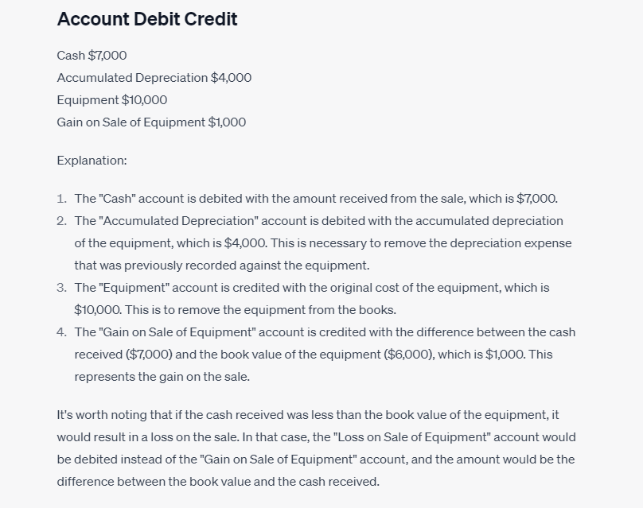
Samples of ChatGPT Responses
What is the journal entry to sell equipment that cost $10,000 with a current book value of $6,000 for $7,000 cash?
ChatGPT

Slide 15
ChatGPT and Accounting Homework, Quiz, and Exam Questions
SAT Exam – Performance of GPT-4
710 (out of 800) on SAT Reading & Writing section
93rd percentile of test-takers
700 (out of 800) on Math section
89th percentile of test-takers
AP Exams – Performance of GPT-4
5 on AP Art History, AP Biology, AP Environmental Science, AP Macroeconomics, AP Microeconomics, AP Psychology, AP Statistics, AP US Government and AP US History.
4 on AP Physics 2, AP Calculus BC, AP Chemistry, and AP World History.

Slide 16
ChatGPT and Accounting Homework, Quiz, and Exam Questions
Issues in Accounting Education, April 18, 2023
The ChatGPT Artificial Intelligence Chatbot: How Well Does It Answer Accounting Assessment Questions?
David Wood et al.
28,085 questions (from instructors and test banks)
ChatGPT – 47.4%, Students – 76.7%
ChatGPT strengths
True/false, multiple-choice
Short answer questions? Only about 30%
Less mathematical topics (auditing, AIS)

Slide 17
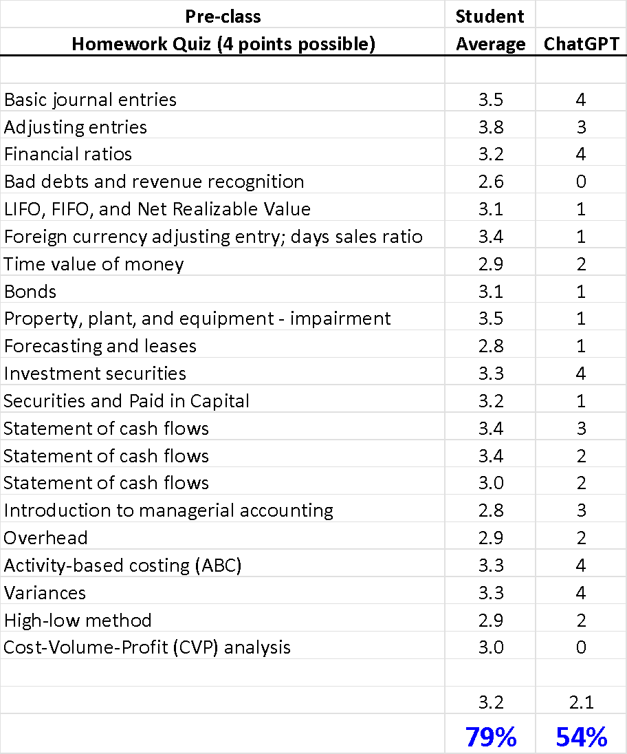
ChatGPT and Accounting Homework, Quiz, and Exam Questions
Jim Stice and Acc 310 (Accounting Principles II)

Slide 18
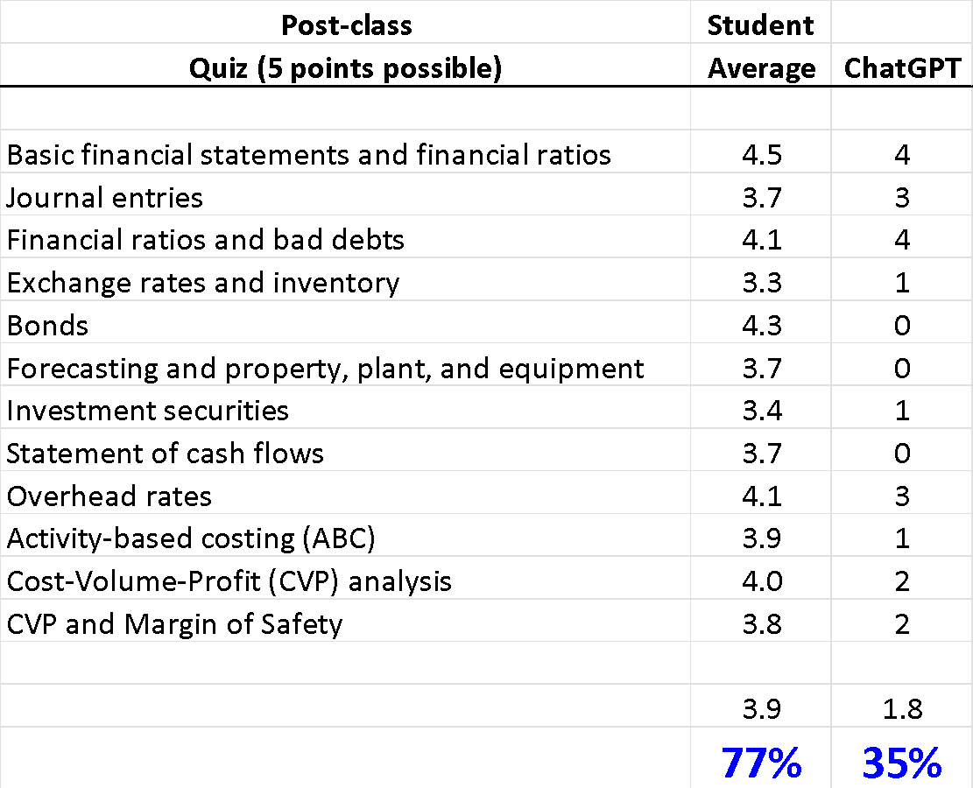
ChatGPT and Accounting Homework, Quiz, and Exam Questions
Jim Stice and Acc 310 (Accounting Principles II)

Slide 19
ChatGPT What Should We Do? – Careful Questions
Pecos Yo Company purchased a machine for $100,000 in cash on January 1 of Year 1. The machine has an estimated useful life of 10 years and an estimated salvage value of $10,000. Pecos Yo Company uses the straight-line method for computing depreciation expense. What is the BOOK VALUE of the machine as of the END of Year 3?
ChatGPT
Annual Depreciation Expense = (Original Cost - Salvage Value) / Useful Life
Annual Depreciation Expense = ($100,000 - $10,000) / 10 = $9,000
Accumulated Depreciation at the end of Year 3 = $9,000 * 3 = $27,000
Book Value at the end of Year 3 = Original Cost - Accumulated Depreciation
Book Value at the end of Year 3 = $100,000 - $27,000 = $73,000
Tried this 5 times; ChatGPT ALWAYS got the correct answer.

Slide 20
ChatGPT What Should We Do? – Careful Questions
Pecos Yo Company purchased a machine for $100,000 in cash on August 1 of Year 1. The machine has an estimated useful life of 10 years and an estimated salvage value of $10,000. Pecos Yo Company uses the straight-line method for computing depreciation expense. What is the BOOK VALUE of the machine as of the END of Year 3?
Correct answer: $78,250 = $100,000 - $9,000 - $9,000 – ($9,000 × 5/12)
ChatGPT
$77,500 – Assumed August 1 was 6 months out of 12
$68,500 – Used 3.5 years of accumulated depreciation
$73,000 – Used 3 full years of accumulated depreciation
This was the most common response.
$79,000 – Assumed August 1 was 4 months out of 12
Tried this 20 times; ChatGPT NEVER got the correct answer.

Slide 21
ChatGPT What Should We Do? – Careful Questions
A business project requires the initial outlay of $200,000 in cash. The project will generate cash inflows of $30,000 at the end of each year for the next 11 years. The appropriate discount rate is 10.0%. What is the NET PRESENT VALUE of this project?
Correct answer: negative $5,148
ChatGPT
Positive $5,860 – used 12 years in calculations instead of 11
Negative $194,723 – incorrectly used Excel NPV function
Negative $62,231 – again incorrectly used Excel NPV function
Negative $95,722 – incorrectly computed present value of annuity
Even though the SETUP was correct
Negative $22,891 – incorrectly computed present value of annuity
Even though the SETUP was correct
Tried this 5 times; ChatGPT NEVER got the correct answer.

Slide 22
ChatGPT What Should We Do? – Careful Questions
A machine costs $200,000 in cash. The machine will generate before-tax cash inflows of $30,000 at the end of each year for the next 10 years. The machine is depreciated, for tax purposes, over 10 years with zero salvage value. The income tax rate is 30%. The appropriate discount rate is 10.0%. What is the NET PRESENT VALUE of this machine?
Correct answer: negative $34,097
ChatGPT
Negative $151,691 – didn’t know depreciation is a non-cash expense
Negative $152,146 – same as above + different (also incorrect) math
Positive $11,547 – correct after-tax cash flows BUT incorrect math
Even though the SETUP was correct
Negative $22,800 – same as above but different incorrect math
Even though the SETUP was correct
Tried this 4 times; ChatGPT NEVER got the correct answer.

Slide 23
ChatGPT What Should We Do? – Careful Questions
On January 1 of Year 1, Tooele Company borrowed $100,000. The annual interest rate on the loan is 12%. What is Tooele Company’s interest expense for Year 1?
ChatGPT got the correct answer of $12,000
On March 1 of Year 1, Tooele Company borrowed $100,000. The annual interest rate on the loan is 12%. What is Tooele Company’s interest expense for Year 1?
ChatGPT computed interest for only the one month of March.
On September 1 of Year 1, Tooele Company borrowed $100,000. The annual interest rate on the loan is 12%. What is Tooele Company’s interest expense for Year 1?
ChatGPT made the classic student mistake: Used 3 months instead of 4 months.

Slide 24
ChatGPT What Should We Do? – Careful Questions
Using IMAGE files
“Inventory amount = $7,800” was included in the homework/quiz file as an image.
Note: You need to work with your students who are sight-impaired to make sure they have files that can be read by text-to-voice readers.

Slide 25
ChatGPT What Should We Do? – Careful Questions
ChatGPT is a bigger concern for courses for which writing and student PAPERS are an important part of the grade.
For example, GPT-4 scored
163 (88th percentile) on the LSAT,
710 (93rd percentile) on the SAT Evidence-Based Reading & Writing, and
169 (99th percentile) on the GRE Verbal.
Geography professor’s suggestion about mitigating student use of ChatGPT to write papers:
Require students to include a HYPERLINK to each paper they cite as a source.
ChatGPT is known to create fictitious papers using reasonable-sounding titles, actual authors in the field, and actual journals.

Slide 26
ChatGPT What Should We Do? – Careful Questions
Don’t forget…
For years we’ve already been dealing with unauthorized student collaboration on homework and on online quizzes.
ChatGPT is just another way for students to engage in unauthorized collaboration.
For many accounting questions, ChatGPT is a particularly UNRELIABLE collaborator.

Slide 27
ChatGPT What Should We Do? – Careful Questions
Give this CAUTION
to Students:
ChatGPT gives its answers with GREAT confidence even when it is wrong. At least in an Accounting course, copying answers from ChatGPT is VERY risky.

Slide 28
ChatGPT What Should We Do? – Assigning Grades
Relative weights of
Homework (including online quizzes)
Class participation
Projects
Exams
High weight on homework:
Good aspect: Rewards student effort
Bad aspect: Encourages cheating, including use of ChatGPT
Hey, cheating/unauthorized collaboration on homework is nothing new.

Slide 29
ChatGPT What Should We Do? – Assigning Grades
Relative weights of
Homework (including online quizzes)
Be careful about putting too much weight → temptation
Class participation
Systematic evaluation; engaging classroom activities (that was our Webinar in April)
Projects
That was our Webinar in June; example later today
Exams
Practice exams … high-value learning tool
High-quality exam questions… error free, appropriate
Exam security!! What about online exams?

Slide 30
ChatGPT What Should We Do? – ChatGPT as a Tutor?
From Sal Khan, founder and CEO of Khan Academy
“When GPT-4 is carefully adapted to a learning environment like Khan Academy, it has enormous potential. It can guide students as they progress through courses and ask them questions like a tutor would.”
Let’s look at one example of using ChatGPT to HELP students learn accounting.

Slide 31
ChatGPT What Should We Do? – ChatGPT as a Tutor?
Give this to the students:
Use the following information to compute NET INCOME. The income tax rate is 40%.
Cost of Goods Sold $ 3,000
Interest Expense 1,100
Selling and Administrative Expense 1,750
Sales 10,000
Dividends 700
Note: Income tax expense is 40 percent of income before taxes.
Correct
Answer:

Slide 32
ChatGPT What Should We Do? – ChatGPT as a Tutor?
ASSIGNMENT:
Copy the question [“compute NET INCOME”] and data into ChatGPT.
Submit the question.
Analyze the answer and explanation returned by ChatGPT. Is the answer correct? If not, describe EXACTLY where ChatGPT went wrong.
Repeat a total of 6 times.

Slide 33
ChatGPT What Should We Do? – ChatGPT as a Tutor?
Correct answer: $2,490
Attempt #1: Net income = $2,790
Mistake? Wrong arithmetic AND subtracted Dividends
Attempt #2: Net income = $2,670
Mistake? Different wrong arithmetic AND subtracted Dividends
Attempt #3: Net income = $2,490
Correct!!!!!
Attempt #4: Net income = $2,790
Mistake? Same mistakes as #1
Attempt #5: Net income = $1,790
Mistake? Correct arithmetic but subtracted Dividends (no taxes)
Attempt #6: Net income = $2,070
Mistake? Included Dividends as a tax-deductible expense

Slide 34
ChatGPT What Should We Do? – Enrich the Classroom
Well-designed in-class group activities have the following benefits.
Keep students more engaged in the classroom discussion compared to straight lecture.
Positively associate the topic in particular and the course subject in general with exploration and active learning.
Associate accounting with analysis, judgment, ethics, and decision making.
Reinforce the idea that real-world decisions are made in teams.
Develop student social interaction skills.
Give students a chance to discuss and debate technical material which develops student oral communication skills.
Provide a setting in which students can develop and practice leadership skills.

Slide 35
ChatGPT What Should We Do? – Enrich the Assignments!
Well-designed OUT-OF-CLASS PROJECTS have the following benefits.
Give students a taste of a more realistic business environment relative to what they get in textbook exercises and classroom discussions.
Immerse students in messy fact situations relative to the sterile, clear-answer settings they get in their homework.
Place students in working group settings in which they learn much more than accounting content: group dynamics, managing workload in a team, schedule planning, and so forth.
Confirm to students that the content they are learning in the classroom really does have some relevance in the real world.

Slide 36
ChatGPT What threat does ChatGPT pose to the teaching of accounting at colleges and universities?
Let’s ASK ChatGPT!!
Dependence on AI for basic knowledge: Students may become overly reliant on AI models.
Reduced emphasis on practical application: AI models may reduce the emphasis on practical application and real-world problem-solving.
Limitations in interactive and hands-on learning: AI models may not fully replicate the interactive and hands-on learning experience that is crucial in accounting education.
Potential misinformation or errors: Students may inadvertently learn incorrect information or rely on flawed analyses if they solely rely on AI models without critical evaluation and verification.
To mitigate these threats, it is essential for accounting educators to include emphasizing critical thinking skills, focusing on practical application and real-world scenarios, promoting active learning strategies, and guiding students in effectively utilizing AI tools.

Slide 37
Projects in Introductory Accounting

Slide 38
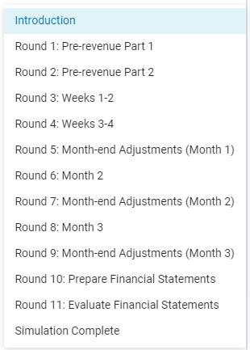

Slide 39
Example of a Typical Round

Slide 41
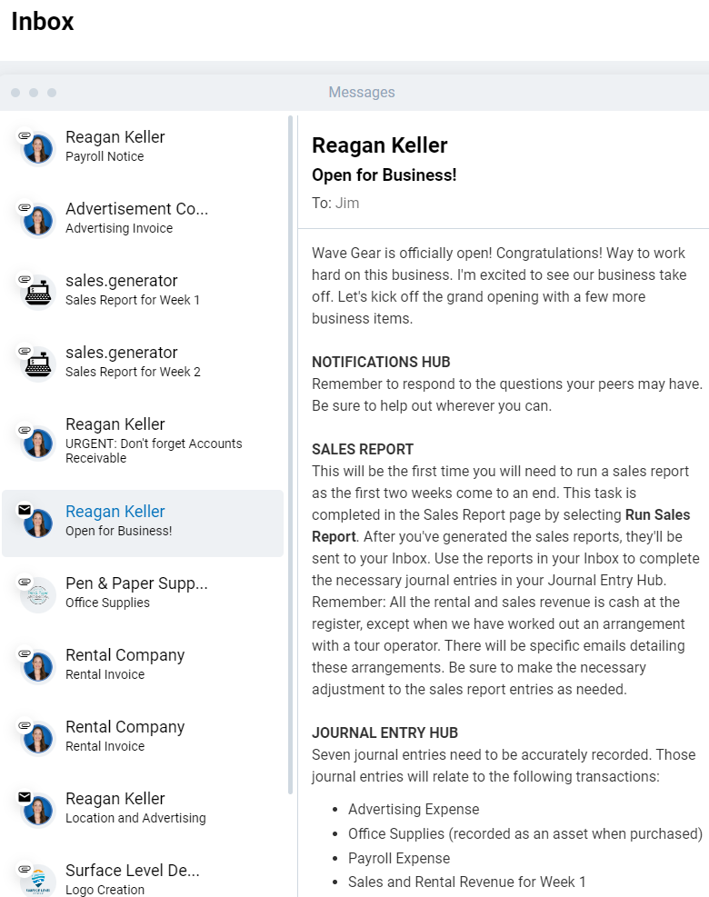

Slide 42
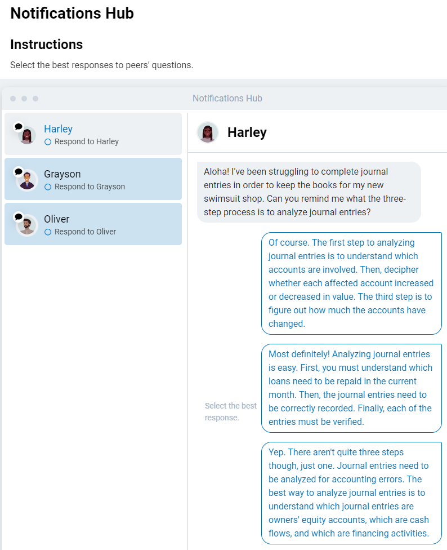

Slide 43
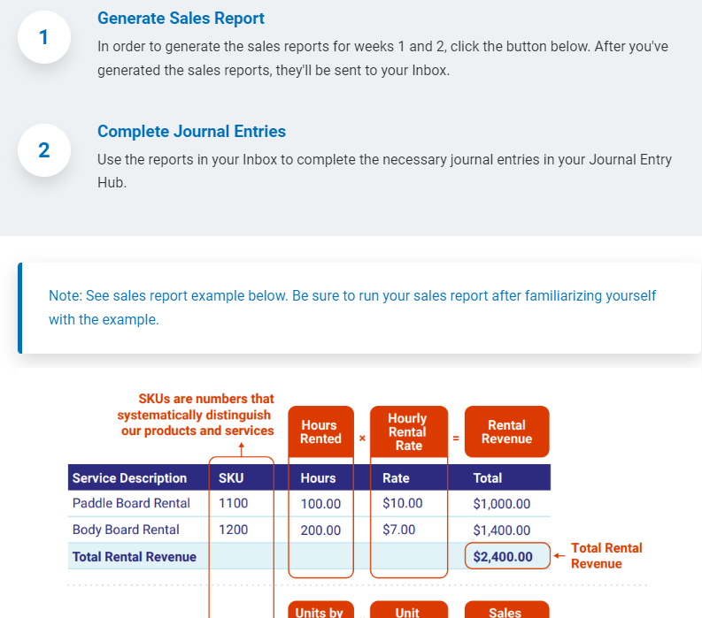

Slide 44
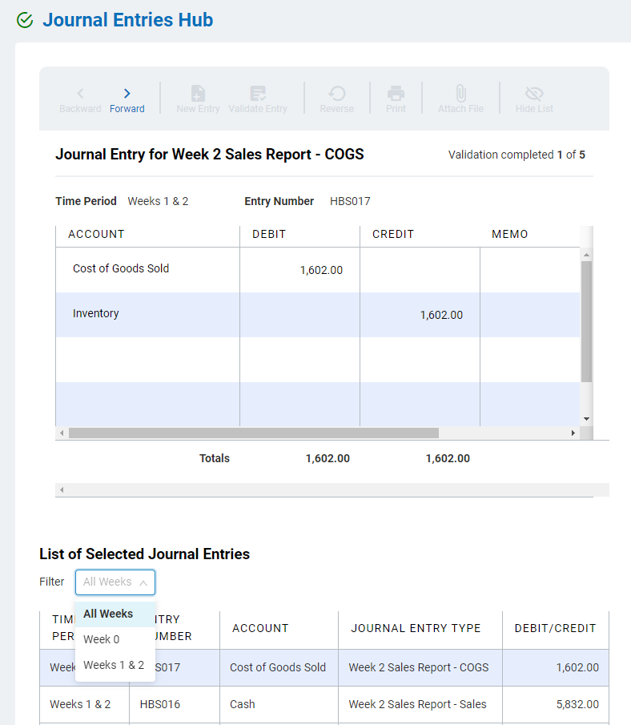
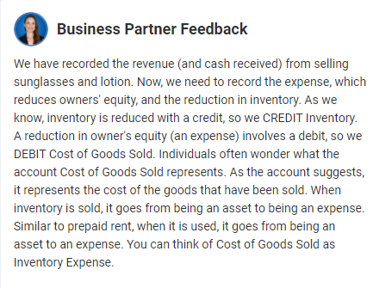

Slide 45
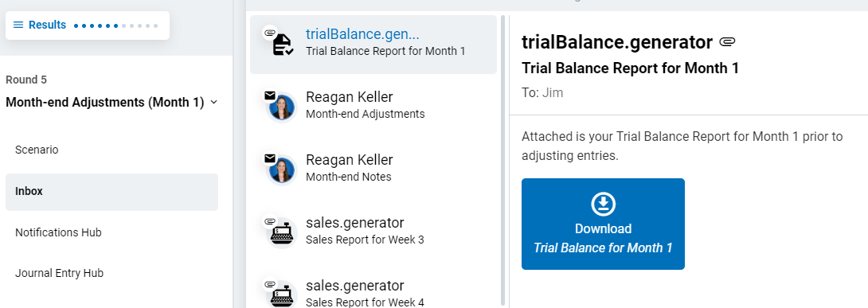
Month-End Adjustments

Slide 46
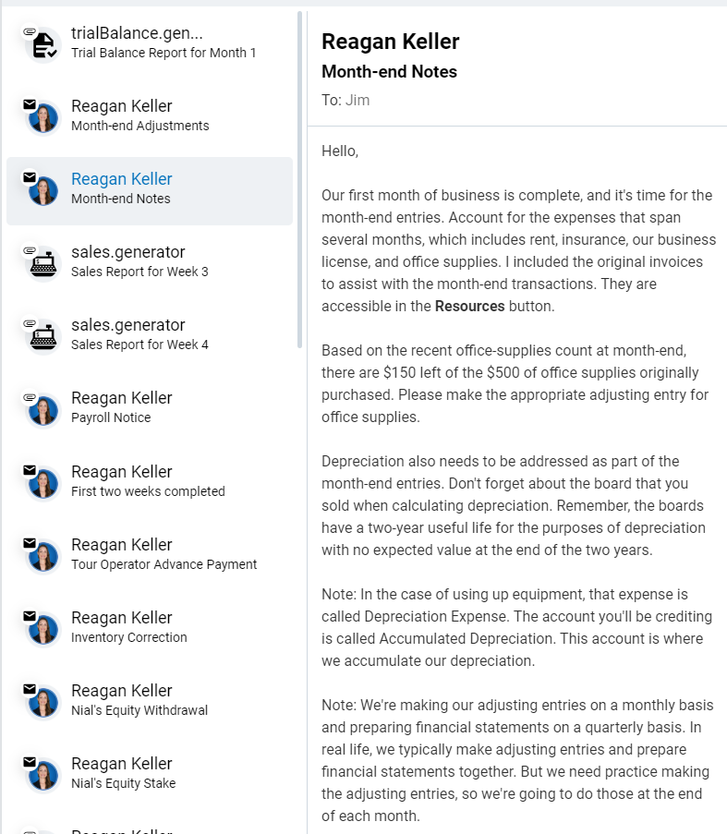

Slide 47
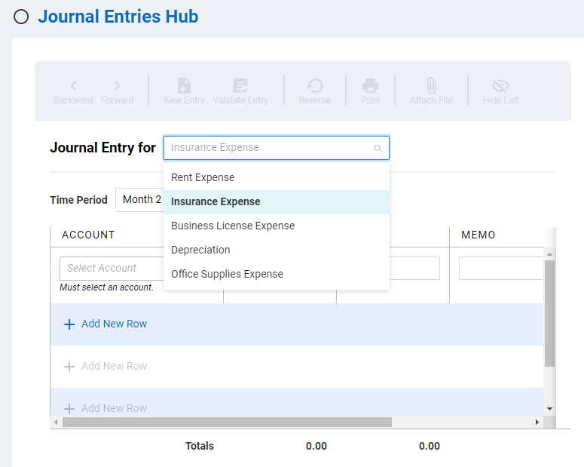
Adjusting Entries

Slide 49
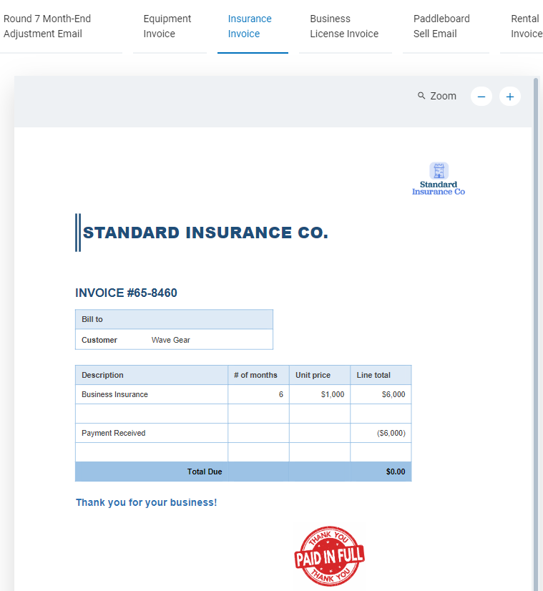

Slide 50
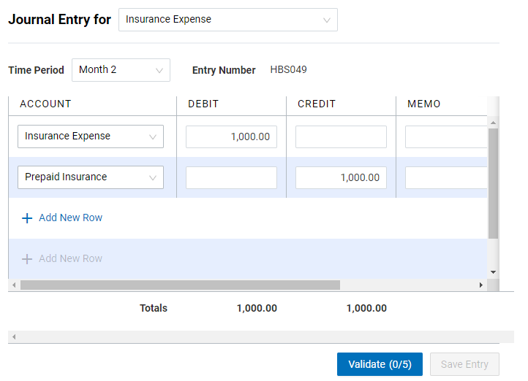

Slide 51
Financial Statements

Slide 52
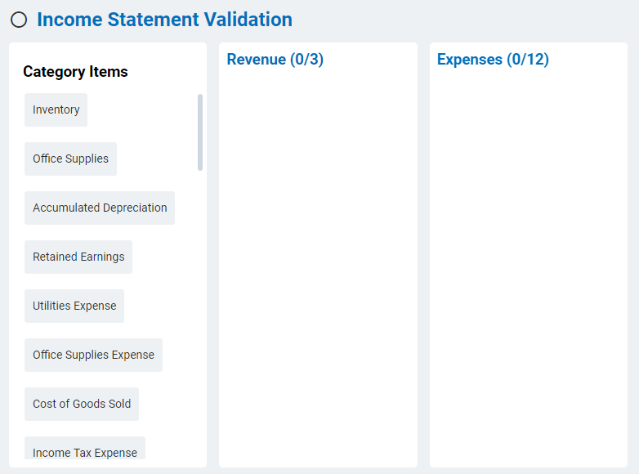

Slide 53
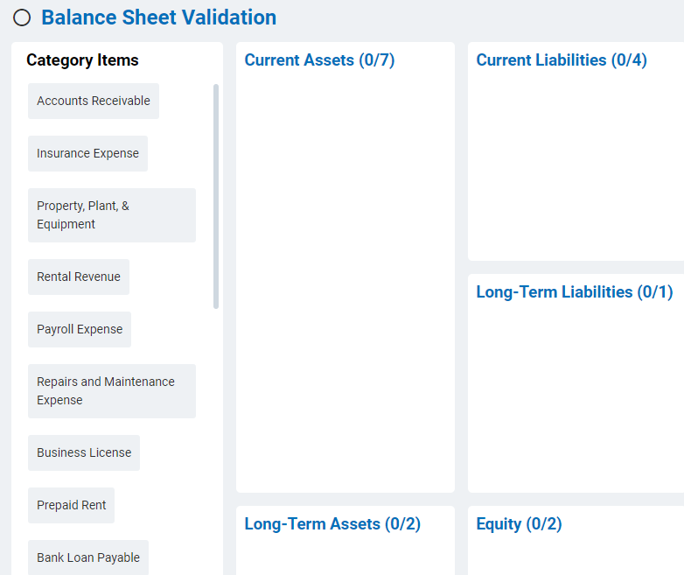

Slide 54
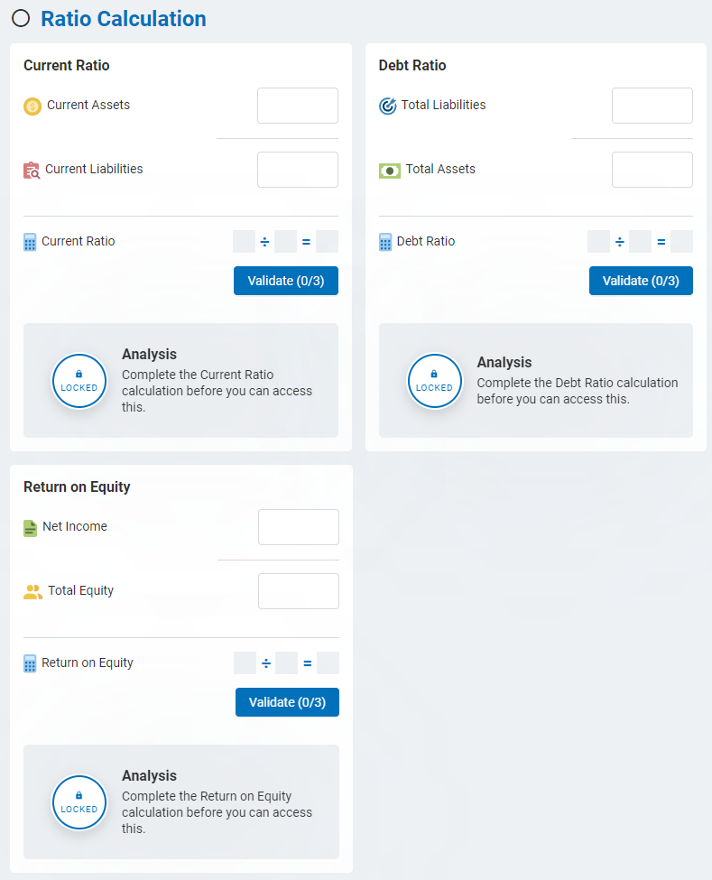

Slide 55
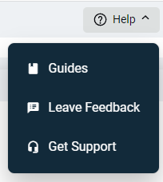
Help for Students

Slide 56
Projects in Introductory Accounting

Slide 57
ChatGPT
and Teaching Accounting:
Threats and Opportunities
James D. Stice
Earl K. Stice
Professors of Accounting Emeriti
Brigham Young University

Slide 58
ChatGPT: Key Points
Background
What is ChatGPT?
From where did it come? Who owns ChatGPT?
What are people saying about ChapGPT? How will it “change the world”?
Samples of ChatGPT Responses
What are the key points of the U.S. Constitution?
Is 17077 a prime number?
What is the journal entry to record the purchase of $4,000 of inventory for cash?
Systematic Research with ChatGPT and Accounting Homework, Quiz, and Exam Questions
David Wood
Jim Stice

Slide 59
ChatGPT: Key Points
What Should We Do? – Careful Questions
Dates, calculations, image files
What Should We Do? – Assigning Grades
Relative weights of homework, class participation, projects, and exams
What Should We Do? – ChatGPT as a Tutor?
Example: Give a problem and solution. Ask students to submit question to ChatGPT. Analyze the answer and explanation returned by ChatGPT. Is the answer correct? If not, describe EXACTLY where ChatGPT went wrong.
What Should We Do? – Enrich the Classroom
Benefits of well-designed, in-class, small-group activities
What Should We Do? – Enrich the Assignments!
Benefits of well-designed, out-of-class, PROJECTS

Slide 60
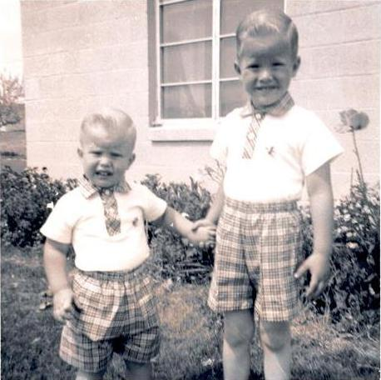
jds@byu.edu
eks@byu.edu

